Slide 1
Taxonomy Visualization Tool
Q4 Hackathon Briefing
Deb Stern & Marie Rodgers
October 20, 2016

Slide 2
Agenda
Tags and the Forrester Taxonomy
Top Search Terms and Client Interests
The Opportunity - it’s HUUUGE
The Data
Possible Approaches and Special Considerations

Slide 3
Tags and the Forrester Taxonomy

Slide 4
Tagging
Every research report is tagged to the following prior to being published onto Forrester.com:
Topic
Role
Industry (if applicable)
Vendor (if applicable)
Geography (if applicable)
Methodology (if applicable) - Forrester Wave, Vendor Landscape, etc.
Market Imperatives (if applicable) - Embrace the Mobile Mind Shift, etc.
Product - Syndicated or data-specific product
Analyst - viewable dimension
Content Type - Wave, Quick Take, Q&A, etc. not viewable on F.com
See Forrester.com’s left-hand sidebar on the Search Results page.

Slide 5
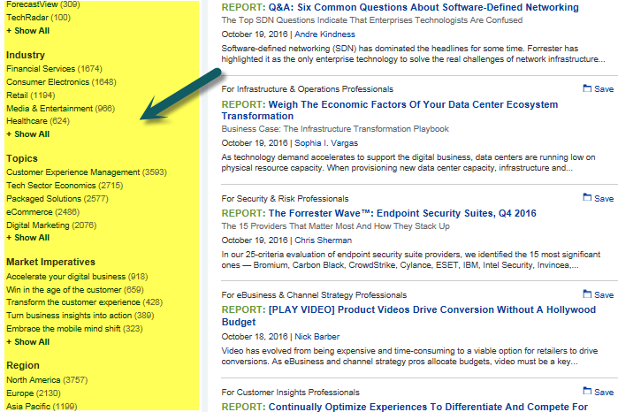

Slide 6

Tags and the Forrester Taxonomy
Other places where the taxonomy appears:
Suggested Tag Search (results are keyword search results though)
Bottom of reports
Analyst bios research coverage
Top of Webinars as “Categories”
Alerts Page interests
iPhone / iPad

Slide 7
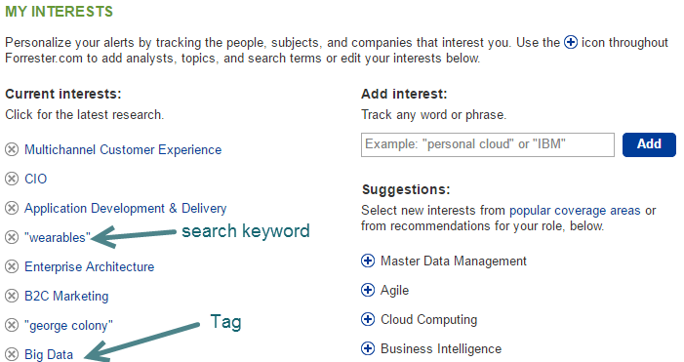
Client Interests

Slide 8
The Opportunity - it’s HUUUGE

Slide 9
For Taxonomy Manager
A taxonomy data visualization tool could enable the taxonomy manager to:
Easily visualize the taxonomy structure, scale and composition
Determine pockets of density and pockets of very little tagging
Determine the average number of reports per tag and the average number of tags per report
Determine which tags to remove, add, merge or propose
Visualize the impact of planned taxonomy changes (enhanced feature)

Slide 10
For Research
A taxonomy data visualization tool could enable research to:
Analyze what we are writing about and to what degree
Filter by analyst, role, industry, geography and other dimensions
View historical data on how our research has evolved over time
Compare what is being written to what clients are looking for
Compare current state of research and compare it with the research plan

Slide 11
For Sales / Client Services
A taxonomy data visualization tool could enable Sales/Client Services to:
Easily identify research topics / documents to fulfill client requests
Easily visualize the composition and scope of research reports (could be particularly helpful when pitching new clients or negotiating a renewal!)
Help identify mismatches between stated client needs and our taxonomy

Slide 12
For Clients and Prospects???
A taxonomy data visualization tool could enable clients and prospects to:
Visualize the breadth of our research product offering
See what topics are currently trending
View historical information and past trending topics
Find research that they want more easily
This would be a future state. For the purpose of this hackathon the focus should be on an internal tool

Slide 13
The Data

Slide 14
Taxonomy Data
Tags, dimensions and associated meta data. Excel file includes:
MetaID from which report URL can be determined e.g. https://www.forrester.com/go?objectid=RESXXXXXX where XXXXXX is the MetaID
Live Date - the date the report was published on Forrester.com
Parent Tag
Child Tag
Role
Report title
RA, Authors and Contributors
Abstract

Slide 15
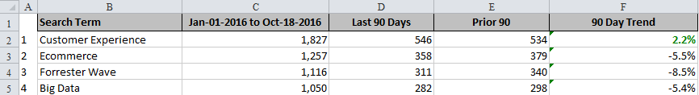

Other Data
Top 5,000 search terms pulled from the data warehouse
Ranking of terms along with # of searches and timeframes/trends
Client Interests - terms ranked by number of subscribers

Slide 16
Possible Approaches and Special Considerations

Slide 17
Possible Approaches (from a novice)
Interactive Tree Maps - http://mbostock.github.io/d3/talk/20111018/treemap.html
Hierarchical Edge Bundling - https://bl.ocks.org/mbostock/7607999
Search / metadata display - http://robinl.github.io/d3_orgchart_yammer/website/
Timelines http://bl.ocks.org/bunkat/2338034 http://bl.ocks.org/rengel-de/5603464 http://bl.ocks.org/tnightingale/4718717

Slide 18
Possible Approaches (from a novice)
Force-directed scatter plots www.coppelia.io/2014/07/an-a-to-z-of-extra-features-for-the-d3-force-layout
Network - http://visjs.org/examples/network/exampleApplications/neighbourhoodHighlight.html
Interactive Circle Packing - https://bl.ocks.org/mbostock/7607535
Interactive Sunburst - http://bl.ocks.org/metmajer/5480307

Slide 19
Special Considerations
The Taxonomy and associated data changes over time
tags and dimensions are changed, added and deleted
hierarchical structure may change (levels removed/added)
search term ranking changes, new terms surface and others decline in popularity/fall off the list
clients add/remove interests
there is no weighting component to tags/tagging
The ability to search, filter dimensions, link directly to reports and see changes over time would be useful

Slide 20
Thank you! Thank you! Thank you!

